Slide 1
Password manager with cryptographic techniques
K.Madhavi
18261A0583
Mentor-Ms Poornima

Slide 2
Introduction:
Many systems rely on passwords for authentication. Due to numerous accounts for different services, users have to choose and remember a significant number of passwords. Password-Manager applications address this issue by storing the user's passwords. They are especially useful on mobile devices, because of the ubiquitous access to the account passwords.

Slide 3
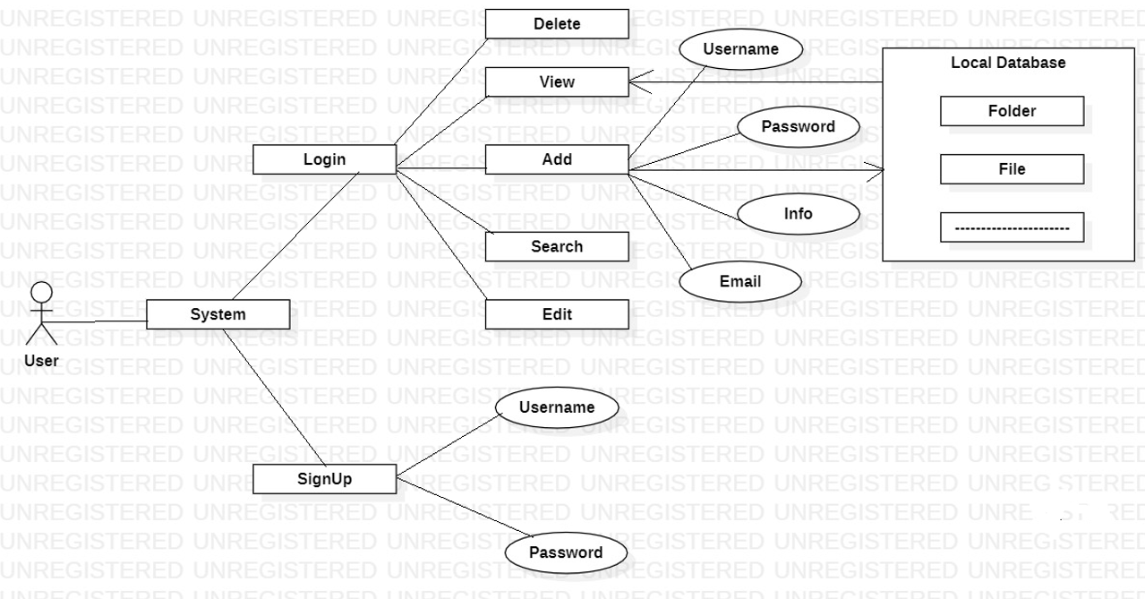
Design:

Slide 4
Methodology:
The approach is to implement the AES Encryption algorithm for storing data in the database.The AES Encryption process contains the round-functions such substitute bytes, shift rows, mix column and add round key . The following figure shows same functions apply to the decryption process are in inverse steps. The process is looping 10 rounds, as the first 9 rounds it will pass through all four 4 functions, and the last round the mix column will not be carried out.

Slide 5
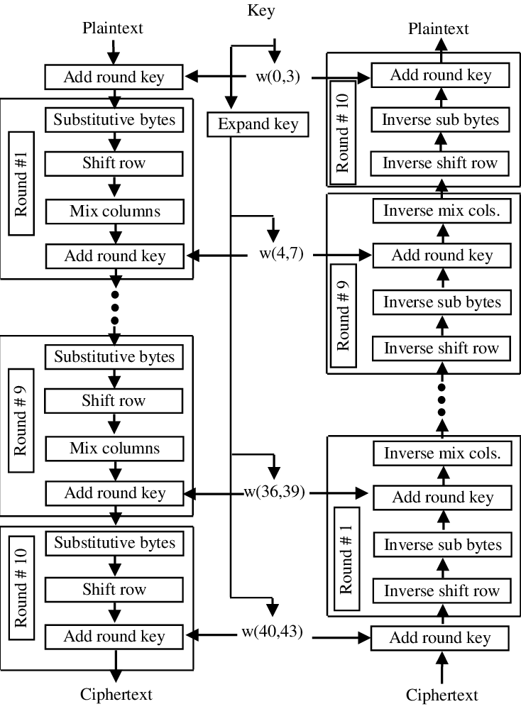

Slide 6
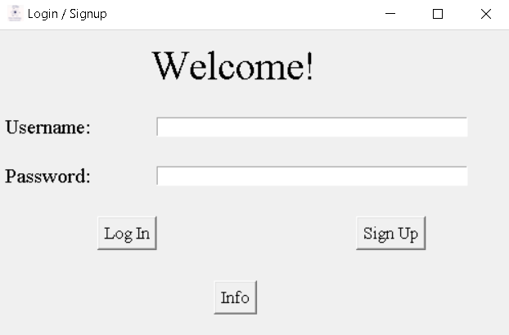
Home page:

Slide 7
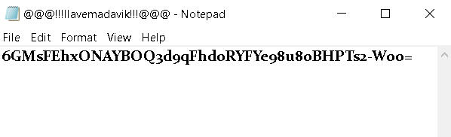
Encrypted login information

Slide 8
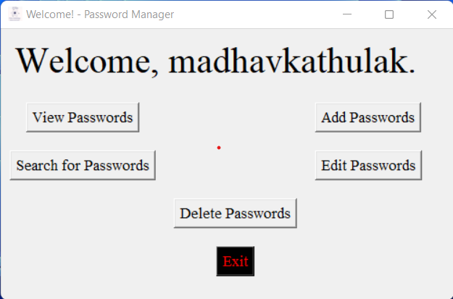
GUI:

Slide 9
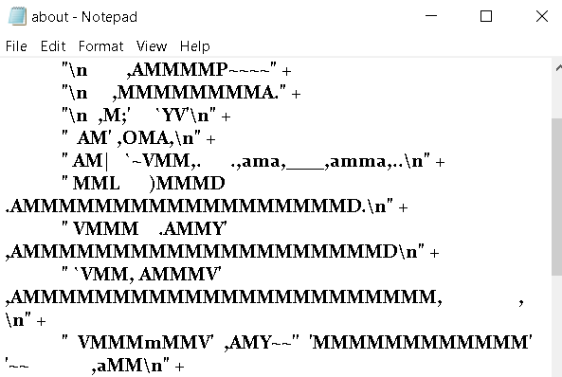
Encrypted passwords.

Slide 10
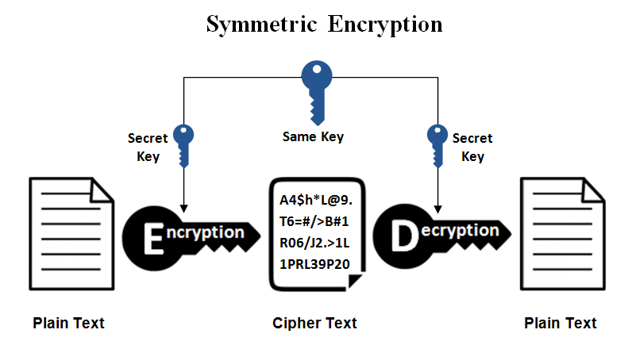

Slide 11
Conclusion:
As the technology evolved, people had many accounts that needed a password for authentication. A password is required to access a particular account or information. However, the way they keep their account information expose them to vulnerable threats such as hacking if the password is not protected appropriately. Password Management Application (PMA) can help user manage and keep their password on different account securely

